Slide 1
Illusory changes in the perceived speed of motion derived from proprioception and touch
Moscatelli, Scotto, and Ernst (2019)
Duncan Tulimieri

Slide 2
Introduction
Visual illusions (Aubert-Fleischl & Filehne)
Perceived velocity of stimulus is different depending on whether the image moves across the retina with eye stationary OR whether the observer moves the eyes to pursue the stimulus such that the pursued stimulus is stationary on the retina
Retinal speed overestimated compared to pursued speed
(app demonstration)

Slide 3
Introduction
Explanation of illusion
1. intrinsic difference in speed measurement between the retinal and the extraretinal signals
2. estimated speed provided by retinal signal will change depending on the spatial frequency of a textured stimulus moving across the retina, possible leading to a mismatch between the retinal and the extraretinal signals
3. difference in precision between retinal and extraretinal signals and thus their differential effects when combined with a prior for object motion

Slide 4
Introduction
Does an illusion like the Aubert-Fleischl illusion exist in other sensory systems, specifically the somatosensory system?
Asked participants to estimate the speed of moving stimulus either from tactile motion, by keeping hand world stationary or from kinesthesia, by tracking the stimulus with a guided upper limb movement

Slide 5
Predictions
If illusion same in haptics as in vision
Expect participants to overestimate the speed of the surface as measured by touch compare with kinesthesia
Additionally
Whether texture of moving surface and perceptual noise affected strength of phenomenon

Slide 6
Methods
Participants
Experiment 1
N=9
Experiment 2
N=12
Experiment 3
N=8

Slide 7
Methods
Apparatus
Fig 1.

Slide 8
Methods
Belts
high-spatial frequency – uniformly spaced, ridged texture
Ridges 1mm tall and 3 mm apart, spatial frequency = 0.3 cycles/mm
medium-spatial frequency – uniformly spaced, ridged texture
Ridges 1mm tall and 4 mm apart, spatial frequency = 0.25 cycles/mm
low-spatial frequency – uniformly spaced, ridged texture
Ridges 1mm tall and ~14 mm apart, spatial frequency = 0.07 cycles/mm
smooth – no detectable elements (elements or dots)
Experiment 1
high-spatial frequency
Experiment 2
high-spatial frequency, low-spatial frequency, and smooth
Experiment 3
Smooth + medium-spatial frequency

Slide 9
Methods
Stimulus and procedure
Trial = stimulus 1 + ISI (2.5s) + stimulus 2
Order of stimulus randomized
Belts moved counterclockwise (leftward motion)
Constant acceleration, plateau, constant deceleration
Plateau speed
Reference = 60 mm/s
Test = pseudo randomly chosen from seven values between 16.7 and 103.2 mm/s
[16.70, 31.12, 45.53, 59.95, 74.37, 88.78, 103.20]
Path length randomly chosen from four values between 140 and 264 mm
[140.00, 181.33, 222.67, 264.00]
Notes:
Path length randomly chosen to “prevent participants from using motion duration as a cue”

Slide 10
Methods
Procedure
Dimly lit room
Black curtain hide device
Earplugs and headphones (playing pink noise)
Report which of the two stimuli was faster
Notes:
Sounds like tv static

Slide 11
Methods
Experiment 1
High frequency belt, kinesthesia or tactile
Report: press right or left button of computer mouse with left hand
4 experimental conditions
Reference + test
KK, TT, KT, and TK
4 conditions X 7 speeds X 20 replications = 560 total trials
2 days (3h / day)

Slide 12
Methods
Experiment 2
Spatial frequency modulate illusion?
Same paradigm as experiment 1, change belt
Belt options: smooth belt, low frequency belt, or high frequency belt
Split-plot design
Prevent cross-over effect
Avoided within-subject design

Slide 13
Methods
Experiment 3
Test for biases in perceived speed across texture
Maintain hand world stationary, estimate from tactile information
Belts
Ridged or smooth
Conditions: RR, SS, RS, and SR

Slide 14
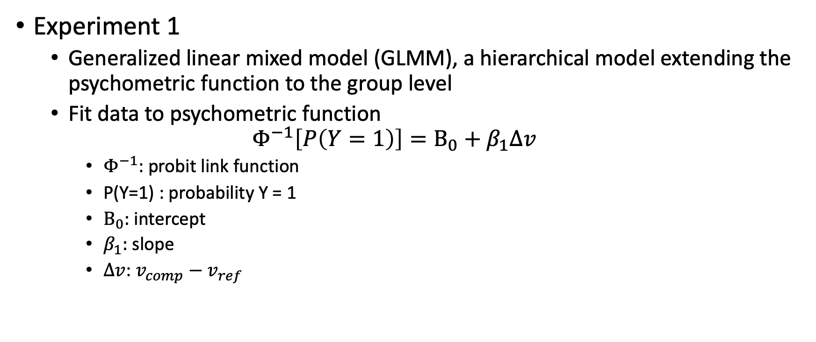
Analysis
Experiment 1
Generalized linear mixed model (GLMM), a hierarchical model extending the psychometric function to the group level
Fit data to psychometric function
$$Φ^{−1}\left[P\left(Y=1\right)\right]=Β_{0}+β_{1}Δv$$
$Φ^{−1}$: probit link function
P(Y=1) : probability Y = 1
$Β_{0}:$ intercept
$β_{1}:$ slope
$Δv$: $v_{comp}−v_{ref}$

Slide 15
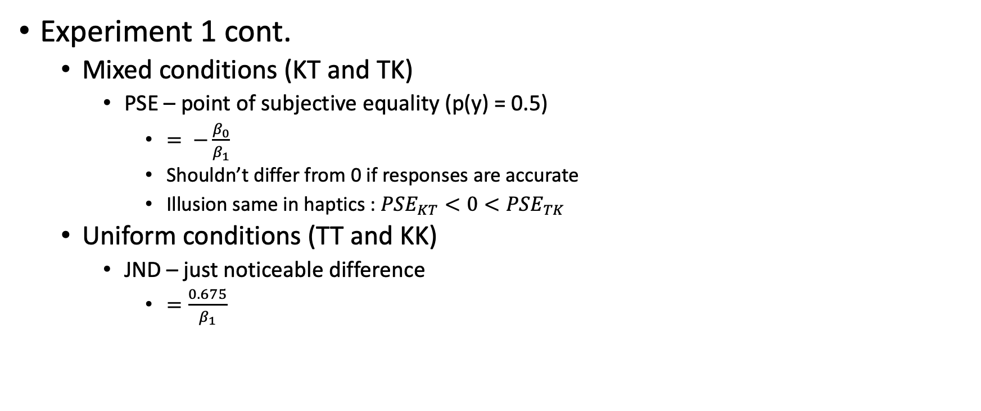
Analysis
Experiment 1 cont.
Mixed conditions (KT and TK)
PSE – point of subjective equality (p(y) = 0.5)
$= −\frac{β_{0}}{β_{1}}$
Shouldn’t differ from 0 if responses are accurate
Illusion same in haptics : $PSE_{KT}<0<PSE_{TK}$
Uniform conditions (TT and KK)
JND – just noticeable difference
$=\frac{0.675}{β_{1}}$

Slide 16
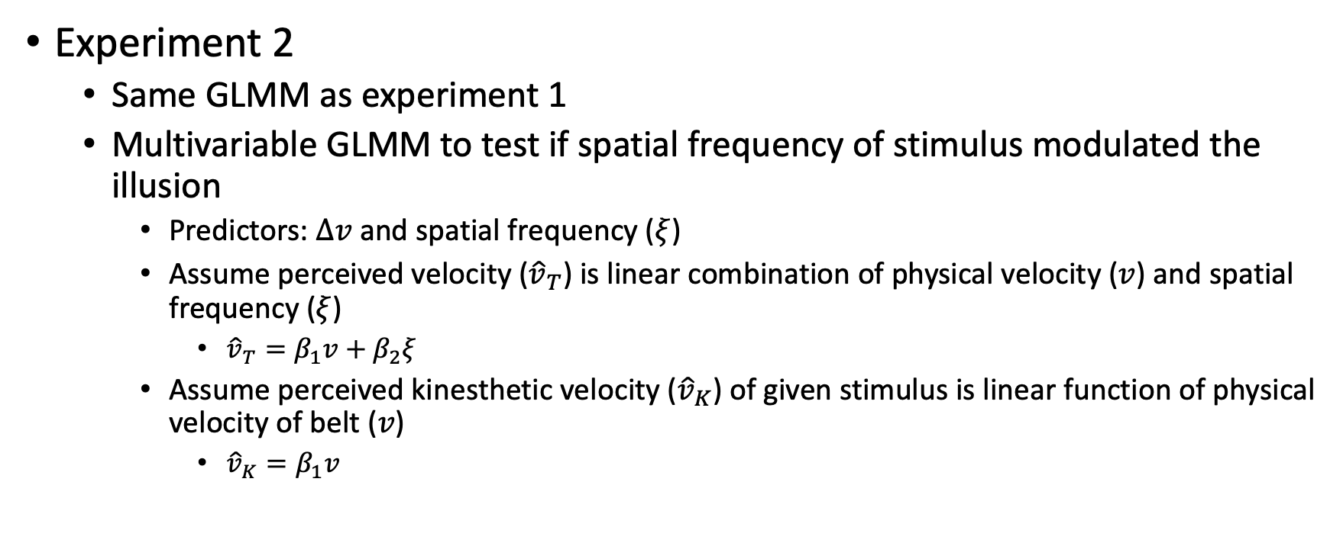
Analysis
Experiment 2
Same GLMM as experiment 1
Multivariable GLMM to test if spatial frequency of stimulus modulated the illusion
Predictors: $Δv$and spatial frequency ($ξ$)
Assume perceived velocity (${\hat{v}}_{T}$) is linear combination of physical velocity ($v$) and spatial frequency ($ξ$)
${\hat{v}}_{T}=β_{1}v+β_{2}ξ$
Assume perceived kinesthetic velocity (${\hat{v}}_{K}$) of given stimulus is linear function of physical velocity of belt ($v$)
${\hat{v}}_{K}=β_{1}v$

Slide 17
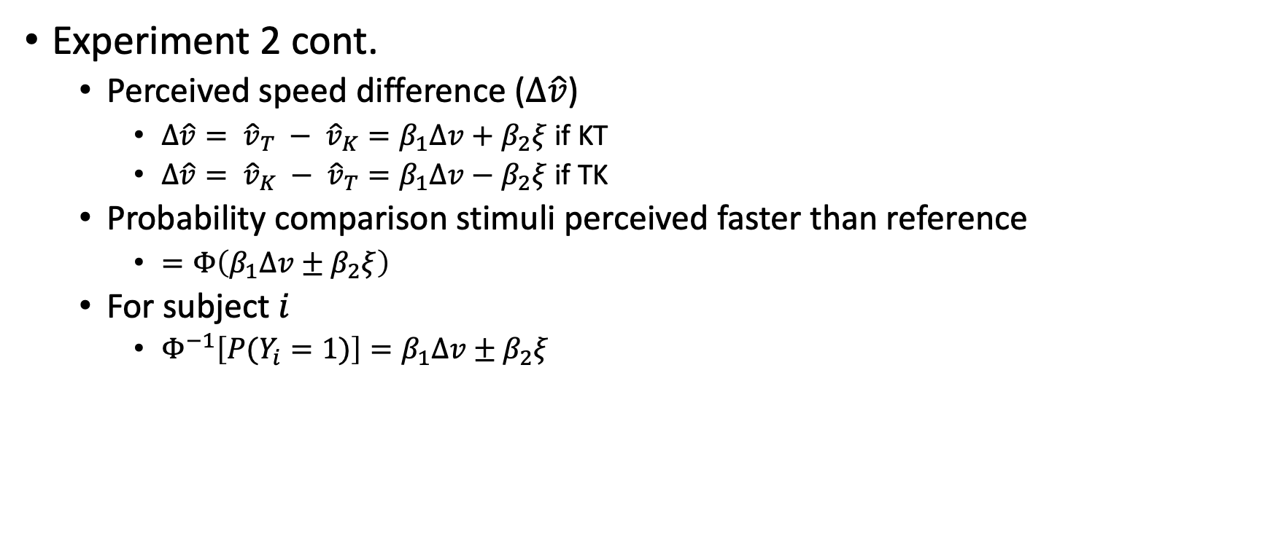
Analysis
Experiment 2 cont.
Perceived speed difference ($Δ\hat{v}$)
$Δ\hat{v}= {\hat{v}}_{T} − {\hat{v}}_{K}=β_{1}Δv+β_{2}ξ$ if KT
$Δ\hat{v}= {\hat{v}}_{K} − {\hat{v}}_{T}=β_{1}Δv−β_{2}ξ$ if TK
Probability comparison stimuli perceived faster than reference
$=Φ\left(β_{1}Δv±β_{2}ξ\right)$
For subject $i$
$Φ^{−1}\left[P(Y_{i}=1)\right]=β_{1}Δv±β_{2}ξ$

Slide 18
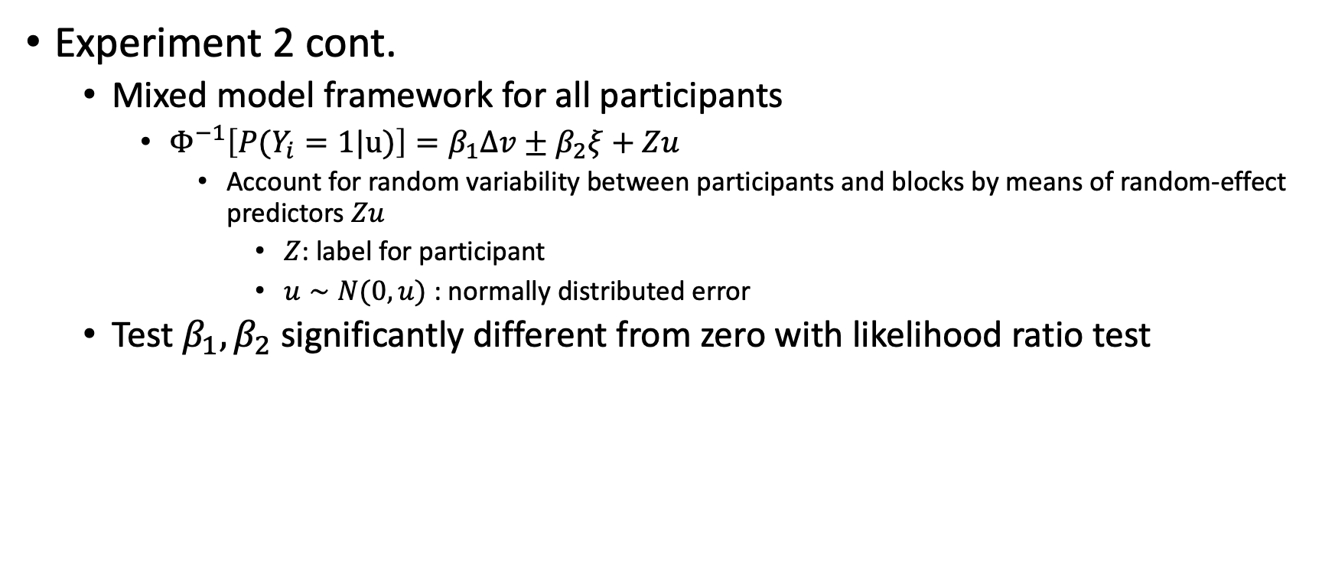
Analysis
Experiment 2 cont.
Mixed model framework for all participants
$Φ^{−1}\left[P(Y_{i}=1|u)\right]=β_{1}Δv±β_{2}ξ+Zu$
Account for random variability between participants and blocks by means of random-effect predictors $Zu$
$Z$: label for participant
$u∼N(0,u)$ : normally distributed error
Test $β_{1}, β_{2}$ significantly different from zero with likelihood ratio test

Slide 19
Results
Experiment 1
Expect:
TK and KT: PSE differ in opposite directions
TT and KK: illusion scale with difference in noise

Slide 20
Results
PSE > 0 : comparison perceived slower than reference
Experiment 1 cont.
Notes:
Participants perceived the velocity of the surface as faster when they measured it from tactile motion, with the hand world stationary, than when they measured it from kinesthesia
If moving stimulus on stationary sensory, more likely to perceive that stimulus as faster
Slopes: KT: 0.048 and TK: 0.039
Task slightly easier in KT than TK
JND – similar across conditions
TT: 11.8 mm/s (95% CI, 10.0-14.0 mm/s)
KK: 12.1 mm/s (95% CI, 10.3-14.6 mm/s)

Slide 21
Results
Experiment 1 all subjects fits

Slide 22
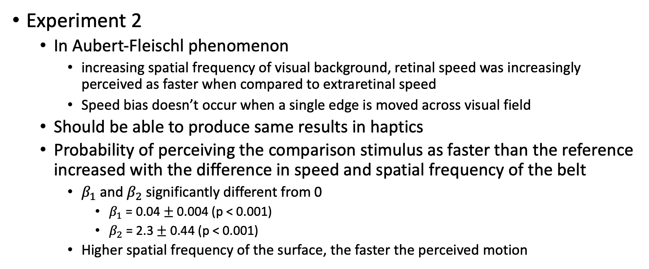
Results
Experiment 2
In Aubert-Fleischl phenomenon
increasing spatial frequency of visual background, retinal speed was increasingly perceived as faster when compared to extraretinal speed
Speed bias doesn’t occur when a single edge is moved across visual field
Should be able to produce same results in haptics
Probability of perceiving the comparison stimulus as faster than the reference increased with the difference in speed and spatial frequency of the belt
$β_{1}$ and $β_{2}$ significantly different from 0
$β_{1}$ = 0.04 $±$ 0.004 (p < 0.001)
$β_{2}$ = 2.3 $±$ 0.44 (p < 0.001)
Higher spatial frequency of the surface, the faster the perceived motion

Slide 23
Results
PSE > 0 : comparison perceived slower than reference
Experiment 2 cont.
Notes:
Smooth PSE
KT: 2.9 mm/s (95 CI, -2.5 – 8.8 mm/s)
TK: 4.3 mm/s (95 CI, 0.24 - 8.9 mm/s)
Low PSE
KT: -9.5 mm/s (95 CI, -16.1 - -3.5 mm/s)
TK: 9.6 mm/s (95 CI, 5.0 – 14.6 mm/s)
High PSE
KT: -10.4 mm/s (95 CI, -17.0 - -4.7 mm/s)
TK: 21.2 mm/s (95 CI, 15.3 – 28.8 mm/s)
Tactile sensed spatial frequency modulated the haptic version of Aubert-Fleischl illusion

Slide 24
Results
Experiment 2

Slide 25
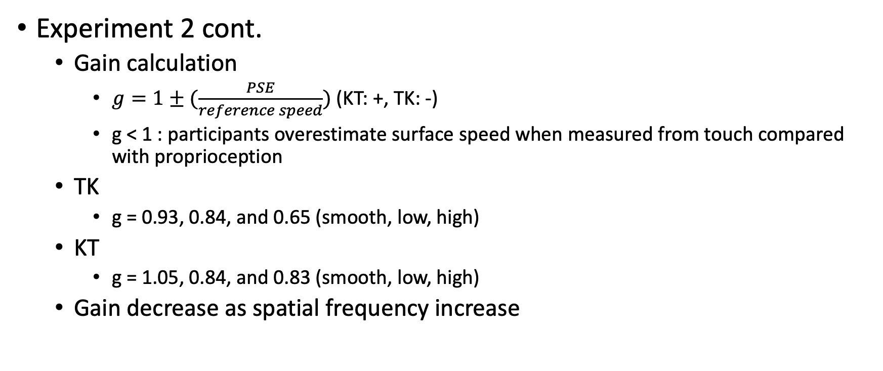
Results
Experiment 2 cont.
Gain calculation
$g=1±(\frac{PSE}{reference speed})$ (KT: +, TK: -)
g < 1 : participants overestimate surface speed when measured from touch compared with proprioception
TK
g = 0.93, 0.84, and 0.65 (smooth, low, high)
KT
g = 1.05, 0.84, and 0.83 (smooth, low, high)
Gain decrease as spatial frequency increase

Slide 26
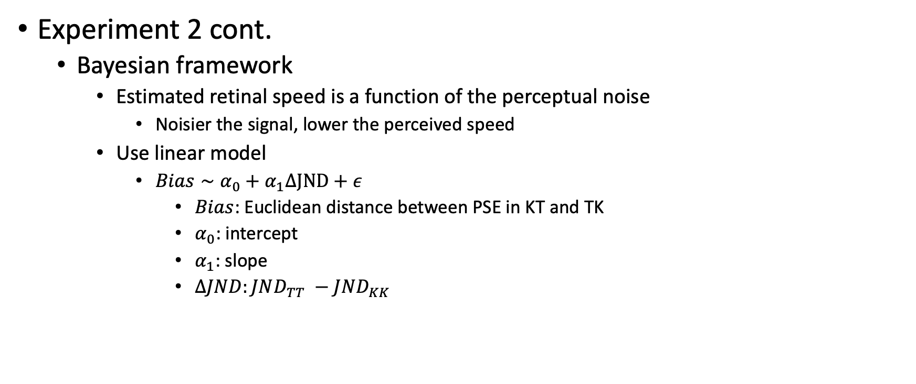
Results
Experiment 2 cont.
Bayesian framework
Estimated retinal speed is a function of the perceptual noise
Noisier the signal, lower the perceived speed
Use linear model
$Bias∼α_{0}+α_{1}ΔJND+ε$
$Bias$: Euclidean distance between PSE in KT and TK
$α_{0}$: intercept
$α_{1}$: slope
$ΔJND:JND_{TT} −JND_{KK}$

Slide 27
Results
Experiment 2 cont.
Notes:
$α_{1}$ = -1.5 (p=0.018)
Difference in noise predicted the size of the bias and thus the magnitude of the illusion

Slide 28
Results
Experiment 2 cont.

Slide 29
Results
Experiment 2 cont.
Third explanation
Speed bias depends on kinesthesia rather than touch
Compare responses for KK condition with all 3 belts
Main effect of belt type and interaction between belt type and speed not significant (p > 0.01)
Notes:
- While pursuing, the belt did not significantly affect the response

Slide 30
Results
Experiment 3
If the modulation of speed bias depends on touch, a moving texture surface would be perceived as faster than smooth surface when both are measured from tactile sensation
Maintain hand world stationary for both stimulus and estimate the speed of motion from tactile measurements only
Contact either textured (medium frequency belt (0.25 cycles/mm)) or smooth surface

Slide 31
Results
PSE > 0 : comparison perceived slower than reference
Experiment 3 cont.
Notes:
JND: provide estimate for discriminability of two stimuli
RR: 13.9 mm/s (95 CI, 12.0-15.7 mm/s)
SS: 17.6 mm/s (95 CI, 14.9-20.3 mm/s)
Speed of motion was easier to discriminate with ridged compared to smooth surface
PSE
RS: 28.5 +- 3.5 mm/s
SR: -7.1 +- 1.3 mm/s
Ridged surface was perceived as moving faster than smooth surface

Slide 32
Results
Experiment 3 cont.

Slide 33
Results
Experiment 3 cont.
Effect size: absolute shift between PSE and reference speed
RS > SR
Absolute values of PSEs were significantly different between two conditions

Slide 34
Discussion
Combining relative motion and sensor motion leads to inaccurate estimates of object motion
Comparing vision and touch
Vision – cycles / deg
Touch – cycles / mm
Slips (visual and tactile)
Perceived tactile speed changes with spatial frequency of textured elements, aligning with idea of different amounts of noise in perceptual estimates
Possible explanation – motion encoding in touch relies (at least partially) on a mechanism akin to EMDs in vision
Notes:
EMDs – response depends on surface pattern: response optima shifted toward larger velocities

